Slide 1
Object Detection
Family of RCNN Models

Slide 2
Before RCNN (2014)
Majority of previous progress on various visual recognition tasks has been based considerably on the use of Scale-invariant feature transform (SIFT) and Histogram of Oriented Gradients (HOG).
But we know that hierarchical, multi-stage processes for computing features that are even more informative for visual recognition.
CNN outperforming other techniques in ImageNet challenge.

Slide 3
Motivation for RCNN
Object Detection = Object localization + object recognition
CNN great at object recognition.
To what extent do the CNN classification result on ImageNet generalize to object detection results on the PASCAL VOC Challenge?

Slide 4
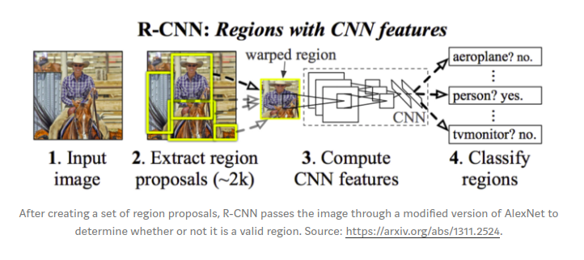

Slide 5
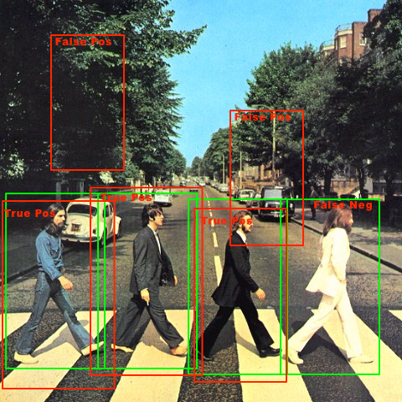
Object Localization
Exhaustive approach – Sliding window

Slide 6
Region Proposal Algorithms
An important property of a region proposal method is to have a very high recall.
RCNN agnostic to region proposals methods but uses Selective search.
Some other algorithms are - category-independent object proposals, constrained parametric min-cuts (CPMC), multi-scale combinatorial grouping.

Slide 7
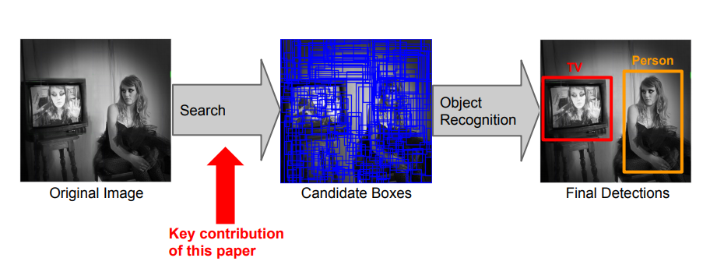
Selective Search

Slide 8
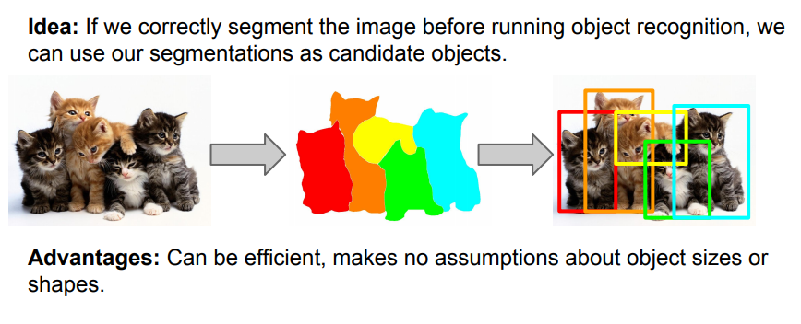
Selective Search - Motivation

Slide 9
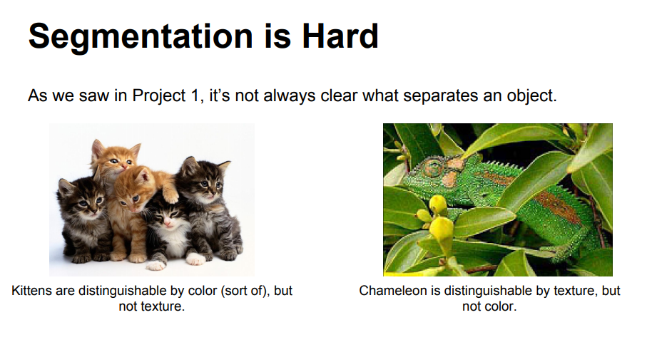

Slide 10
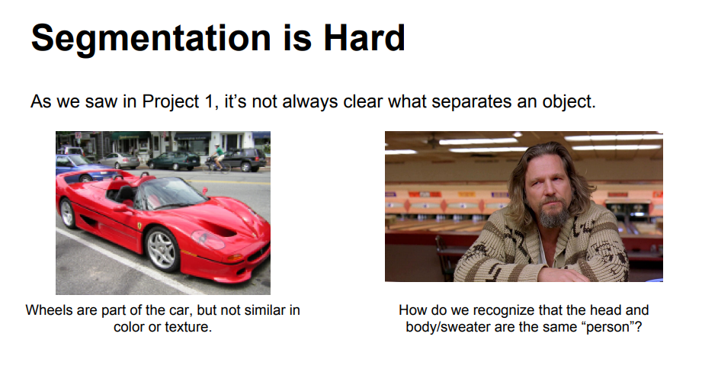

Slide 11
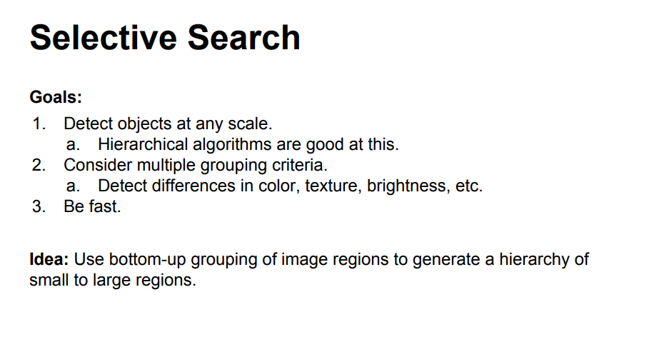

Slide 12
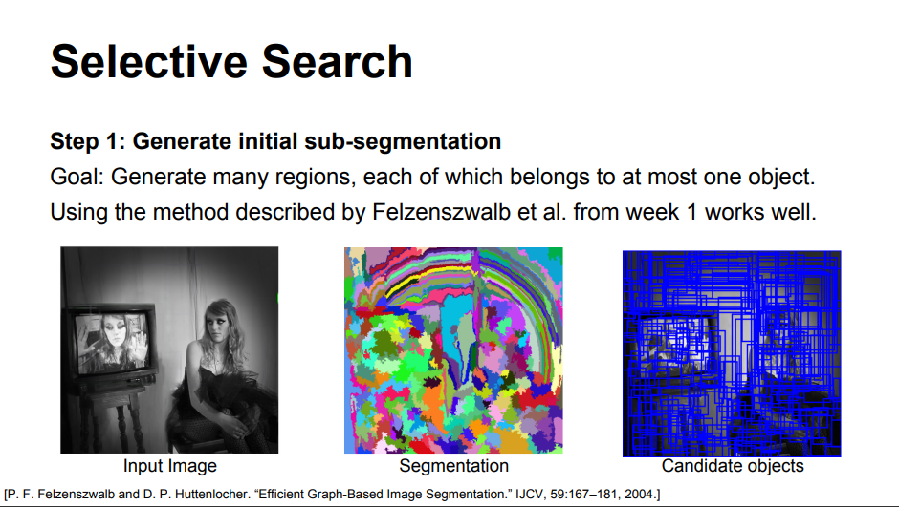

Slide 13
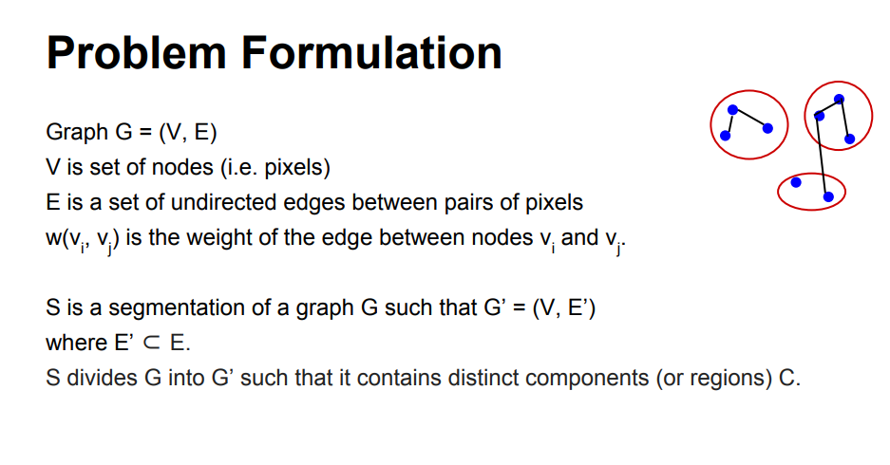
Efficient Graph-Based Image Segmentation by Felzenszwalb and Huttenlocher
http://vision.stanford.edu/teaching/cs231b_spring1415/slides/ranjay_pres.pdf

Slide 14
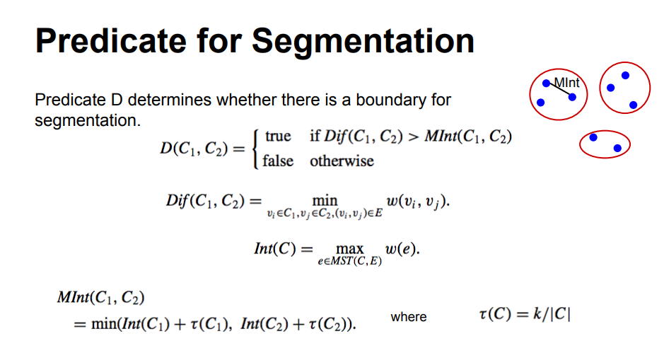
http://vision.stanford.edu/teaching/cs231b_spring1415/slides/ranjay_pres.pdf

Slide 15
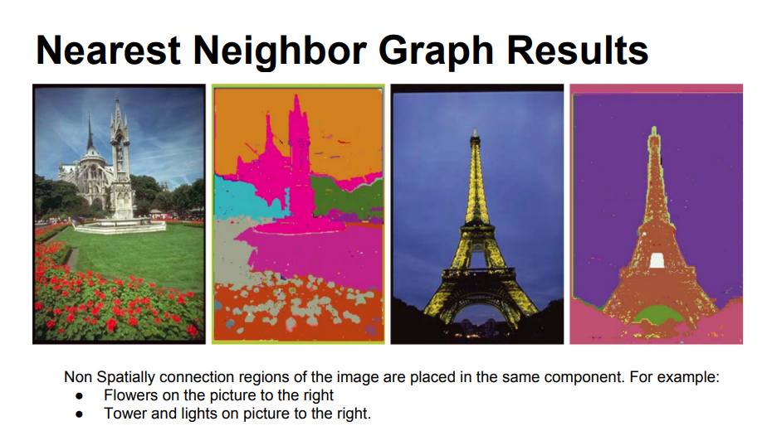

Slide 16

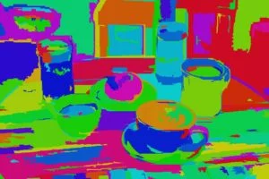
Drawbacks
Most of the actual objects in the original image contain 2 or more segmented parts
Region proposals for occluded objects such as the plate covered by the cup or the cup filled with coffee cannot be generated using this method
https://www.learnopencv.com/selective-search-for-object-detection-cpp-python/

Slide 17
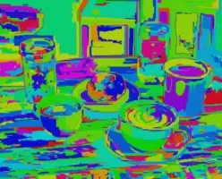
STEP - 1
We want high recall, thus Selective search uses oversegments from Felzenszwalb and Huttenlocher’s method as an initial seed. An oversegmented image looks like this.

Slide 18
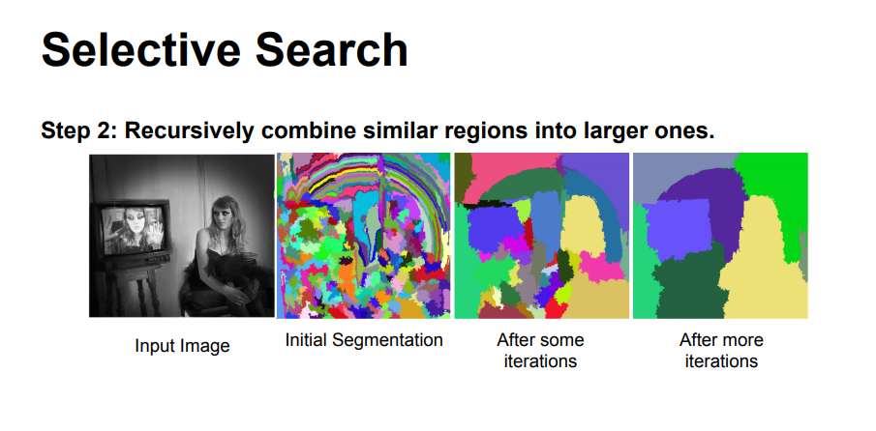

Slide 19
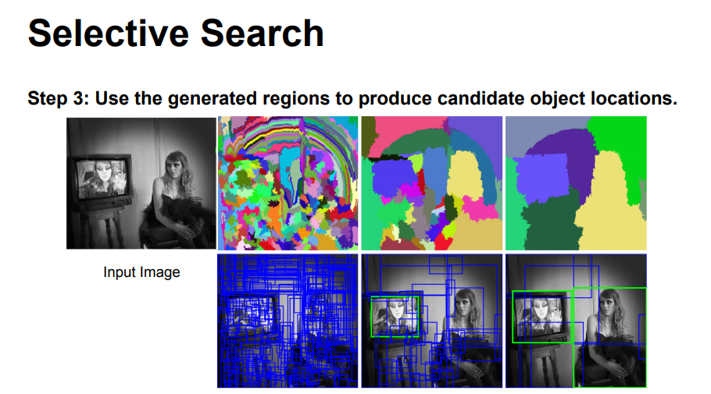

Slide 20
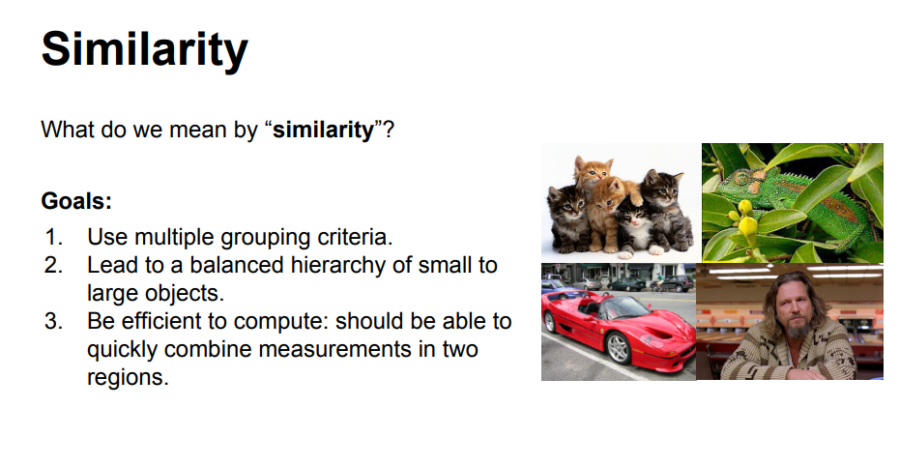

Slide 21
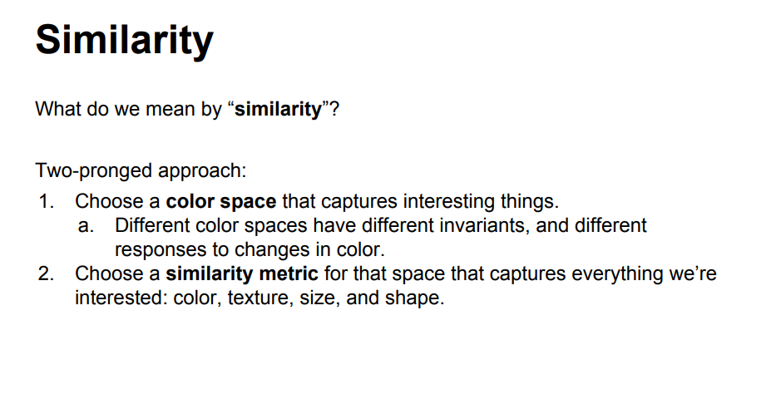

Slide 22
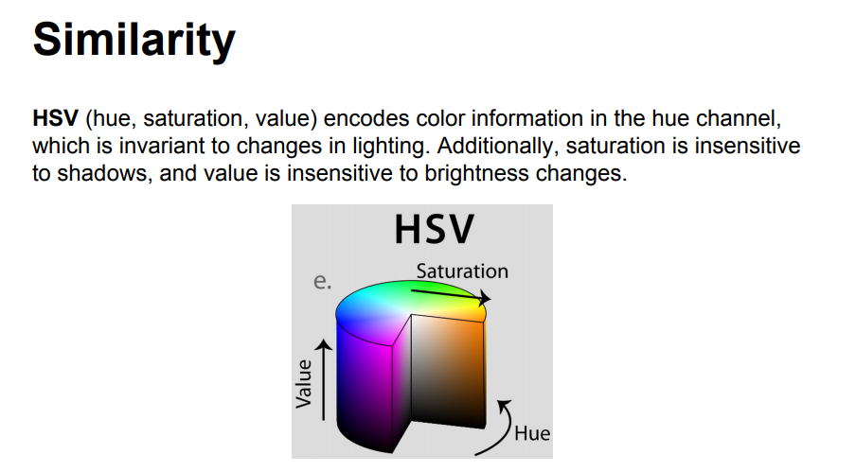

Slide 23
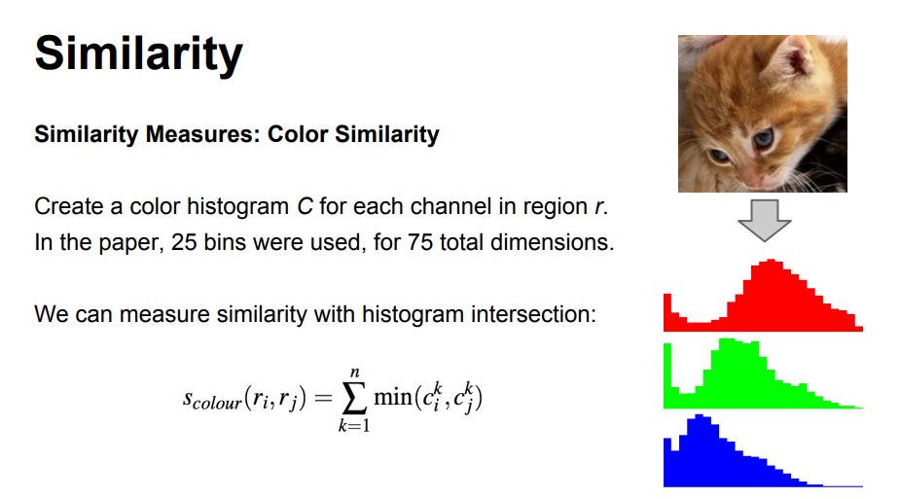
http://vision.stanford.edu/teaching/cs231b_spring1415/slides/ranjay_pres.pdf

Slide 24
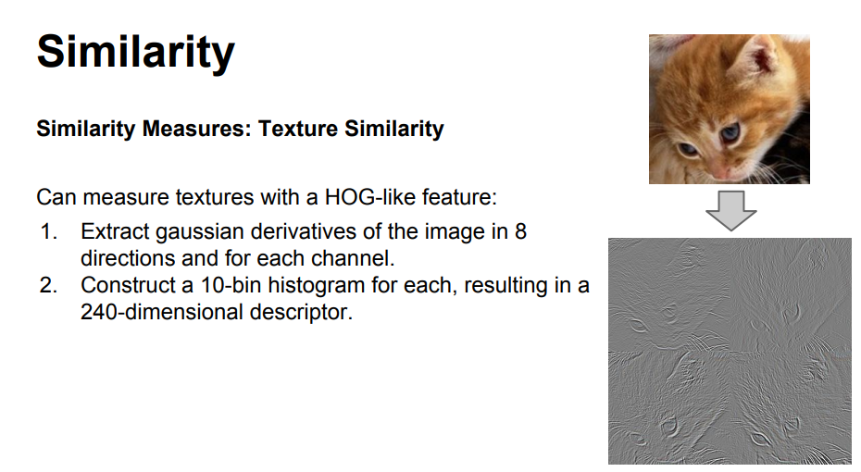
http://vision.stanford.edu/teaching/cs231b_spring1415/slides/ranjay_pres.pdf

Slide 25
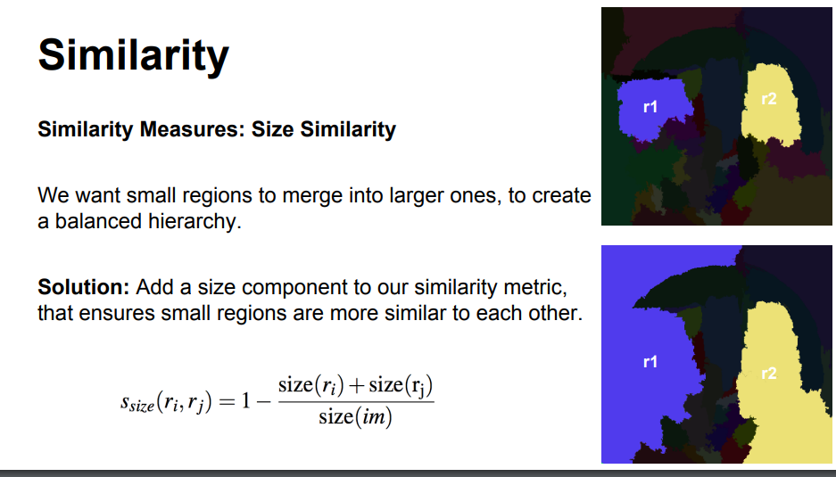
http://vision.stanford.edu/teaching/cs231b_spring1415/slides/ranjay_pres.pdf

Slide 26
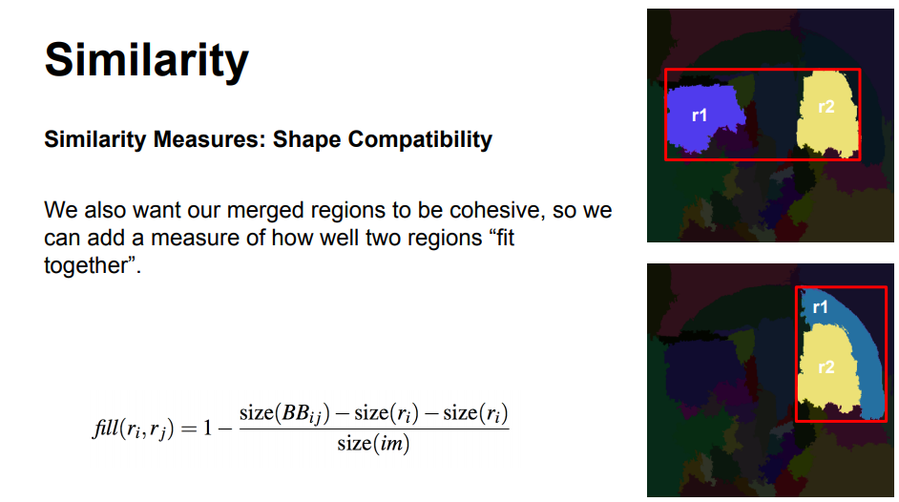
http://vision.stanford.edu/teaching/cs231b_spring1415/slides/ranjay_pres.pdf

Slide 27
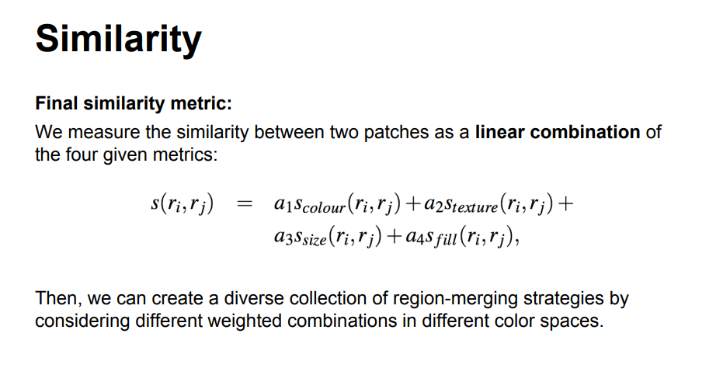

Slide 28
Selective search
Selective Search starts by over-segmenting the image based on intensity of the pixels using a graph-based segmentation method by Felzenszwalb and Huttenlocher.
At each iteration, larger segments are formed and added to the list of region proposals. Hence, we create region proposals from smaller segments to larger segments in a bottom-up approach. This is what we mean by computing “hierarchical” segmentations using Felzenszwalb and Huttenlocher’s oversegments.

Slide 29
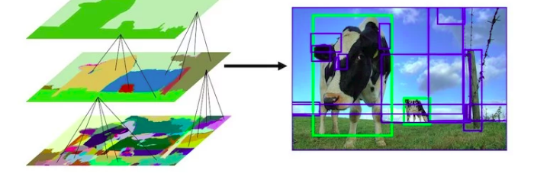
This image shows the initial, middle and last step of the hierarchical segmentation process.

Slide 30
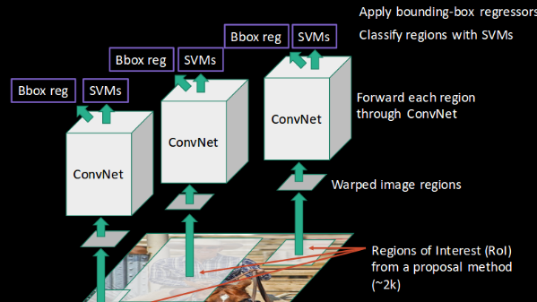

Slide 31
Model Workflow
Pre-train a CNN network on image classification tasks; for example, VGG or ResNet trained on ImageNet dataset. The classification task involves N classes.
Propose category-independent regions of interest by selective search (~2k candidates per image). Those regions may contain target objects and they are of different sizes.
Region candidates are warped to have a fixed size as required by CNN.
Continue fine-tuning the CNN on warped proposal regions for K + 1 classes; The additional one class refers to the background (no object of interest). In the fine-tuning stage, we should use a much smaller learning rate and the mini-batch oversamples the positive cases because most proposed regions are just background.

Slide 32
Model Workflow
Given every image region, one forward propagation through the CNN generates a feature vector. This feature vector is then consumed by a binary SVM trained for each class independently.
The positive samples are proposed regions with IoU (intersection over union) overlap threshold >= 0.3, and negative samples are irrelevant others.
To reduce the localization errors, a regression model is trained to correct the predicted detection window on bounding box correction offset using CNN features.

Slide 33
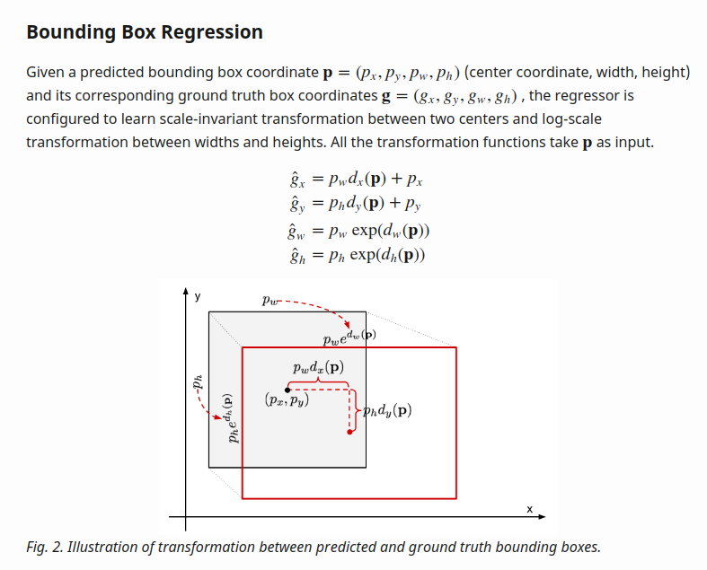
https://lilianweng.github.io/lil-log/2017/12/31/object-recognition-for-dummies-part-3.html#r-cnn

Slide 34
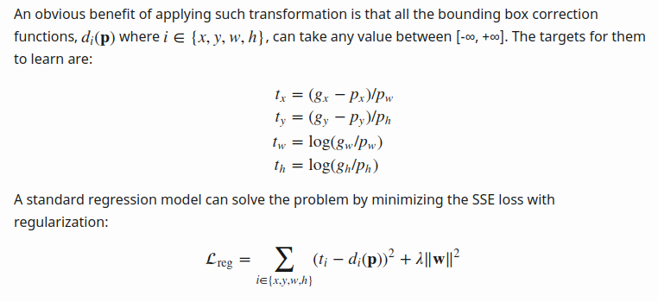

Slide 35
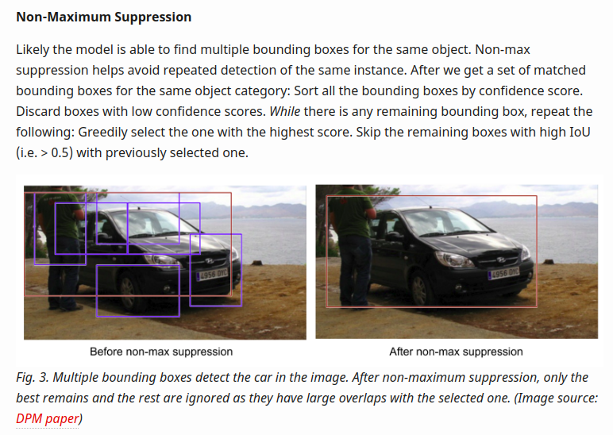

Slide 36
Hard Negative mining
We consider bounding boxes without objects as negative examples. Not all the negative examples are equally hard to be identified. For example, if it holds pure empty background, it is likely an “easy negative”; but if the box contains weird noisy texture or partial object, it could be hard to be recognized and these are “hard negative”.
The hard negative examples are easily misclassified. We can explicitly find those false positive samples during the training loops and include them in the training data so as to improve the classifier.

Slide 37
Speed Bottleneck
Looking through the R-CNN learning steps, you could easily find out that training an R-CNN model is expensive and slow, as the following steps involve a lot of work:
Running selective search to propose 2000 region candidates for every image;
Generating the CNN feature vector for every image region (N images * 2000).
The whole process involves three models separately without much shared computation: the convolutional neural network for image classification and feature extraction; the top SVM classifier for identifying target objects; and the regression model for tightening region bounding boxes.

Slide 38
Drawbacks
Training is a multi-stage pipeline
Training is expensive in space and time
Object detection is slow - At test-time, features are extracted from each object proposal in each test image. Detection with VGG16 takes 47s / image (on a GPU).

Slide 39
Fast RCNN
To make R-CNN faster, Girshick (2015) improved the training procedure by unifying three independent models into one jointly trained framework and increasing shared computation results, named Fast R-CNN.

Slide 40
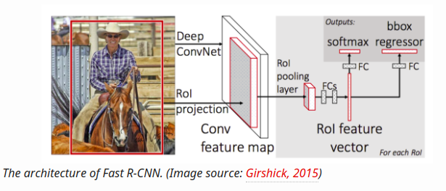

Slide 41
Architecture
The network first processes the whole image with several convolutional (conv) and max pooling layers to produce a conv feature map.
Then, for each object proposal a region of interest (RoI) pooling layer extracts a fixed-length feature vector from the feature map.
Each feature vector is fed into a sequence of fully connected (fc) layers that finally branch into two sibling output layers: one that produces softmax probability estimates over K object classes plus a catch-all “background” class and another layer that outputs four real-valued numbers for each of the K object classes. Each set of 4 values encodes refined bounding-box positions for one of the K classes.

Slide 42
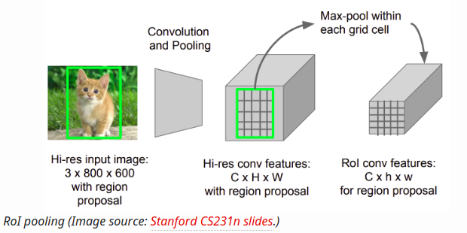
ROI Pooling

Slide 43
ROI pooling
RoI max pooling works by dividing the h × w RoI window into an H × W grid of sub-windows of approximate size h/H × w/W
Then max-pooling the values in each sub-window into the corresponding output grid cell.
https://deepsense.ai/region-of-interest-pooling-explained/

Slide 44
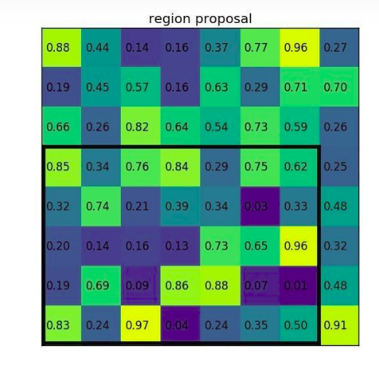
https://deepsense.ai/region-of-interest-pooling-explained/

Slide 45
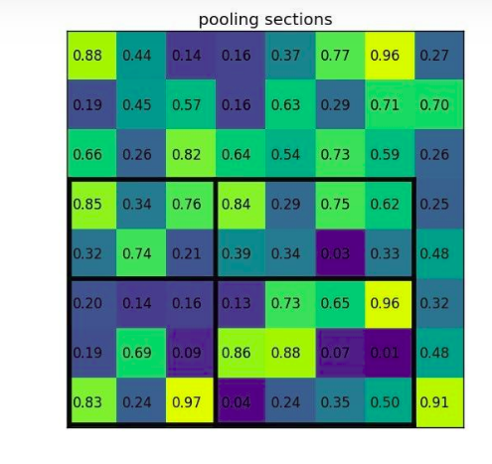
https://deepsense.ai/region-of-interest-pooling-explained/

Slide 46
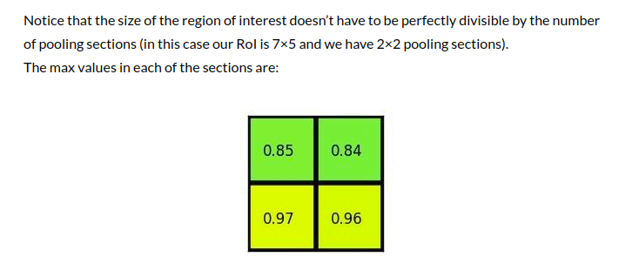

Slide 47
CNN architecture transformation
the last max pooling layer is replaced by a RoI pooling layer that is configured by setting H and W to be compatible with the net’s first fully connected layer (e.g., H = W = 7 for VGG16)
the network’s last fully connected layer and softmax (which were trained for 1000-way ImageNet classification) are replaced with the two sibling layers described earlier (a fully connected layer and softmax over K + 1 categories and category-specific bounding-box regressors).
Third, the network is modified to take two data inputs: a list of images and a list of RoIs in those images.

Slide 48
Benefits
State-of-the-art mAP on VOC07, 2010, and 2012
Fast training and testing compared to R-CNN, SPPnet
Fine-tuning conv layers in VGG16 improves mAP

Slide 49
Speed bottleneck
Fast R-CNN is much faster in both training and testing time. However, the improvement is not dramatic because the region proposals are generated separately by another model and that is very expensive.

Slide 50
Faster RCNN
An intuitive speedup solution is to integrate the region proposal algorithm into the CNN model. Faster R-CNN (Ren et al., 2016) is doing exactly this: construct a single, unified model composed of RPN (region proposal network) and fast R-CNN with shared convolutional feature layers.

Slide 51
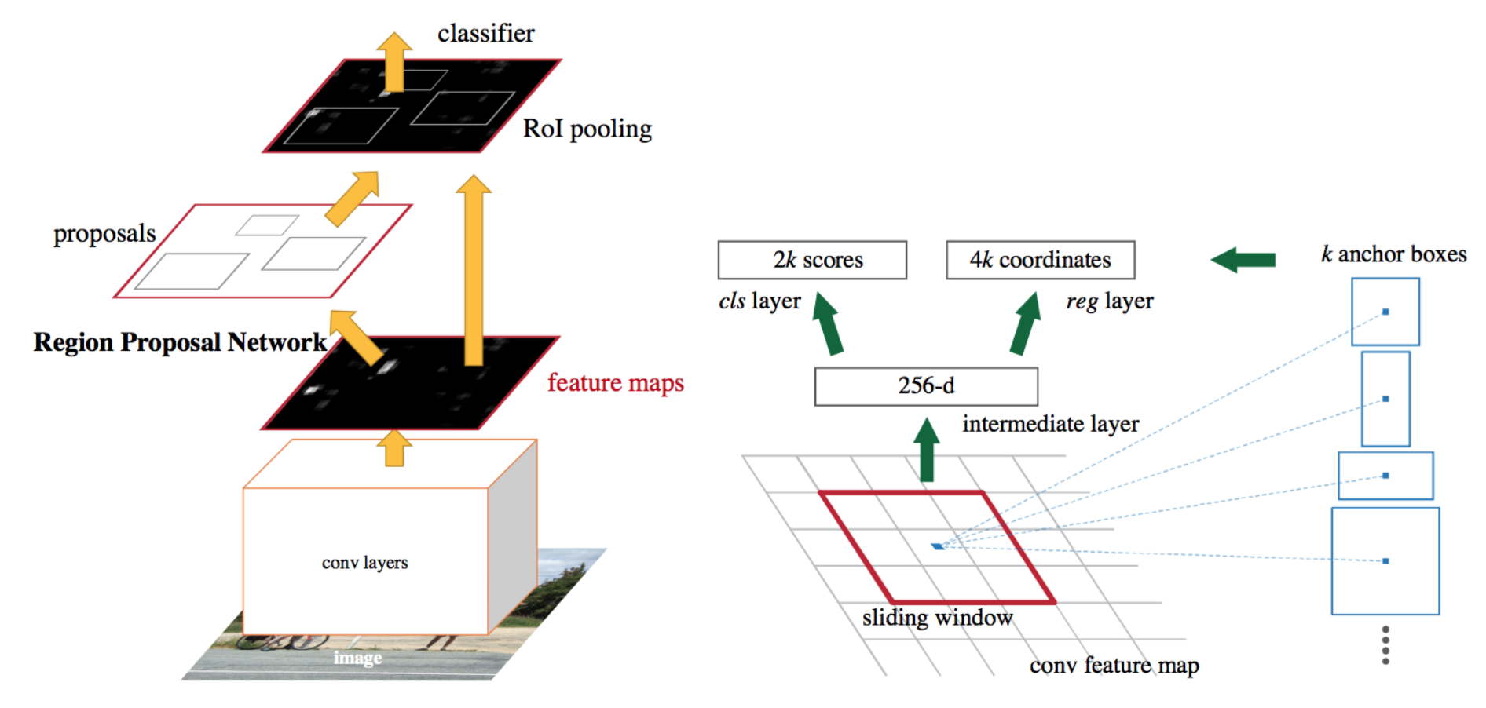
Architecture

Slide 52
RPN (Region Proposal Network)
It outputs a set of rectangular object proposals, each with an objectness score.
It takes as input an n × n spatial window of the input convolutional feature map
In this paper n is 3
The effective receptive field on the input image is large (171 and 228 pixels for ZF and VGG, respectively).

Slide 53
Anchors
Detect multiple region proposals where maximum possible proposals for each location is denoted as k
So the reg layer has 4k outputs and the cls layer outputs 2k scores.
2k scores as for simplicity they implemented as 2 class softmax.
Anchor is centered at center of sliding window
Benefit of anchor is that they are translation invariant
By default we use 3 size and 3 aspect ratio, producing k = 9

Slide 54
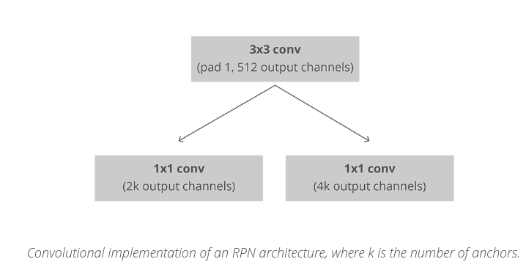

Slide 55
Loss Function
Binary class label
We assign a positive label to two kinds of anchors:
(i) the anchor/anchors with the highest Intersection-overUnion (IoU) overlap with a ground-truth box
(ii) an anchor that has an IoU overlap higher than 0.7 with any ground-truth box.
Negative label if IoU is < 0.3

Slide 56
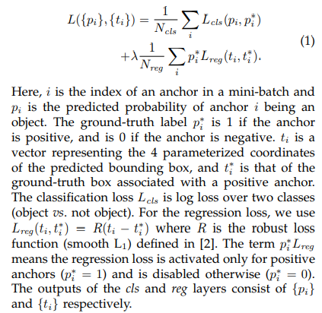

Slide 57
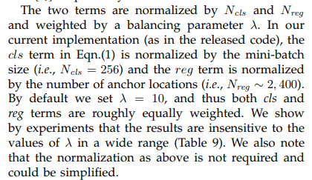

Slide 58
Different Bounding box regression from previous
In ROI based methods, bounding-box regression is performed on features pooled from arbitrarily sized RoIs, and the regression weights are shared by all region sizes.
Here the features used for regression are of the same spatial size (3 × 3) on the feature maps.
To account for varying sizes, a set of k bounding-box regressors are learned.
Each regressor is responsible for one scale and one aspect ratio, and the k regressors do not share weights

Slide 59
Training RPN
Anchors have 2 categories -
1. IoU >0.5 is foreground
2. IoU <0.1 is background
Randomly sample to from mini batch of size 256, trying to maintain a balanced ratio between foreground and background anchors.
Classification loss using binary cross entropy
For calculating the targets for the regression, we use the foreground anchor and the closest ground truth object and calculate the correct Δ needed to transform the anchor into the object.

Slide 60
Training RPN
Instead of using a simple L1 or L2 loss for the regression error, the paper suggests using Smooth L1 loss. Smooth L1 is basically L1, but when the L1 error is small enough, defined by a certain σ, the error is considered almost correct and the loss diminishes at a faster rate.

Slide 61
Non-maximum suppression
To solve the issue of duplicate proposals we use a simple algorithmic approach called Non-Maximum Suppression (NMS).
NMS takes the list of proposals sorted by score and iterates over the sorted list, discarding those proposals that have an IoU larger than some predefined threshold with a proposal that has a higher score.
After applying NMS, we keep the top N proposals sorted by score. In the paper N=2000 is used, but it is possible to lower that number to as little as 50 and still get quite good results.

Slide 62
